Slide 1
Welcome to Spring Framework
DBTS 2020
Gabriel Grigore

Slide 2
Day 2
Spring Framework basics

Slide 3
Spring Framework
Core
Web
AOP
Data Access
Integration
Testing

Slide 4
Spring Framework : Core
Web
AOP
Data Access
Integration
Testing
Core
Notes:
Features:

Slide 5
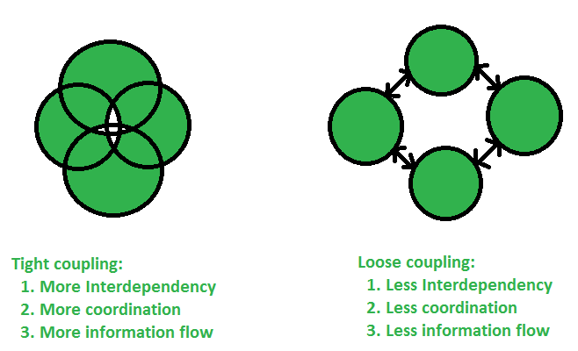
Spring Framework : Core
Internationalization (i18n)
Validation
Data binding
Type conversion
Dependency Injection
Tight coupling
Loose coupling
Spring Core is a dependency injection container.

Slide 6

Spring Framework : Web
Web MVC
Uses servlets : “receives a request and generates a response”
Standard Request > Webserver > Servlet API > Business Logic > Response
WebMVC Request > ?
Spring Web handles web requests.

Slide 7
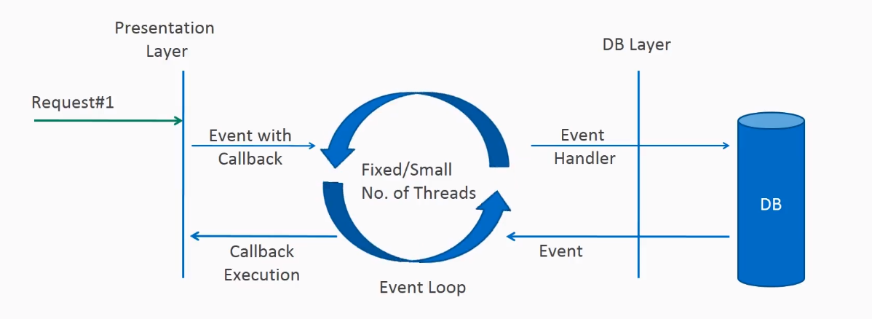
Spring Framework : Web
Webflux react to rather than wait for change.
Webflux
Uses reactive programming concepts;
Declarative programming paradigm;
Uses data streams;
Propagation of change;

Slide 8
Spring Framework : AOP
Aspect Oriented Programming:
Programming paradigm that…
…improve the coding for…
…concerns that span multiple tiers or layers of an app;
Without it…
Code would be scattered;
Code would be much more duplicated;
In Spring itself
It offer solution to internal approaches;
Also exposes functionality for developers for cross-cutting concerns;

Slide 9
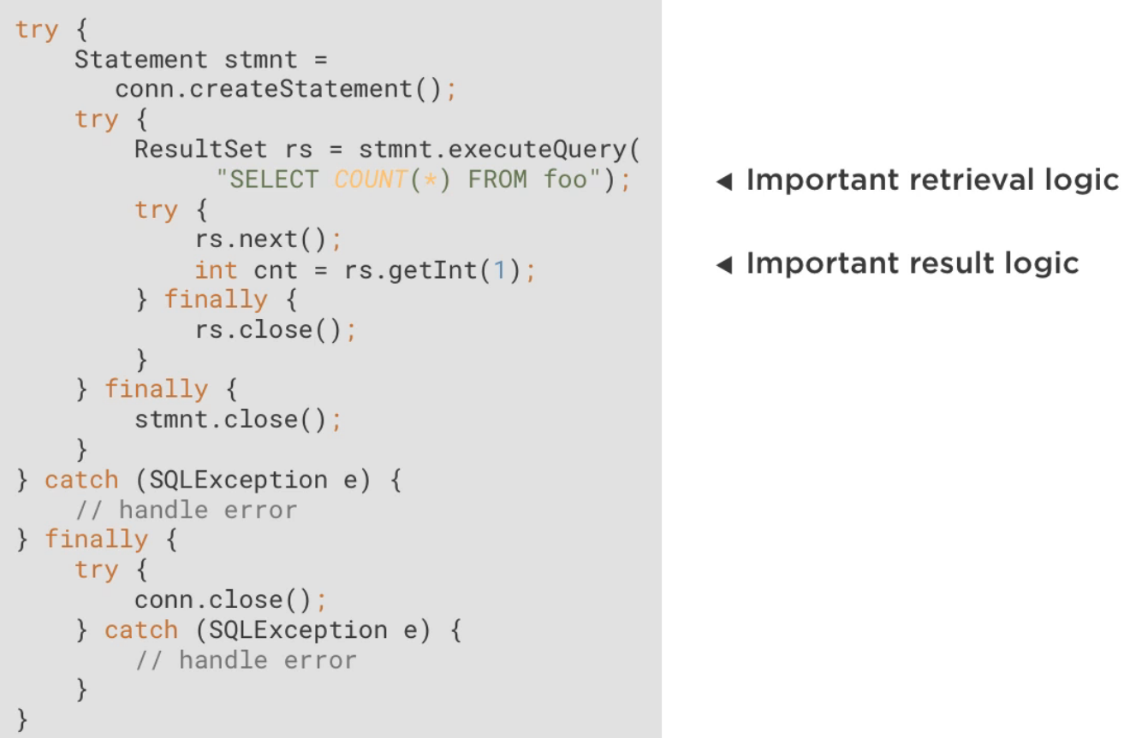
Spring Framework : Data Access

Slide 10
Spring Framework : Data Access

Slide 11
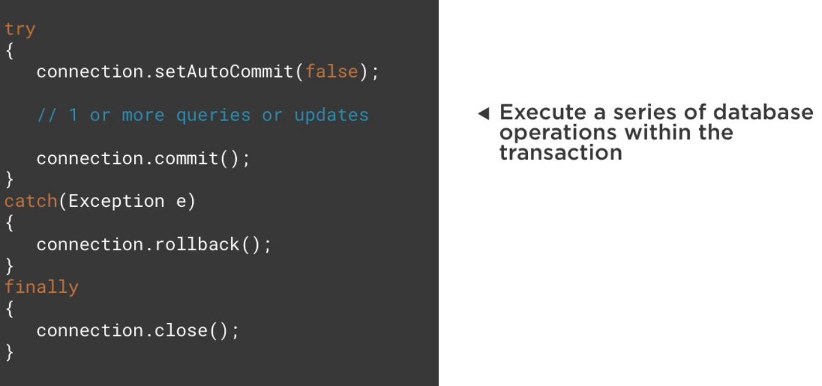
Spring Framework : Data Access

Slide 12
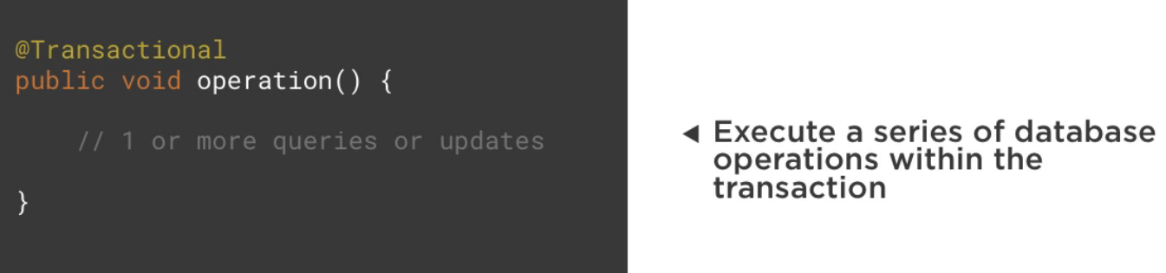
Spring Framework : Data Access

Slide 13
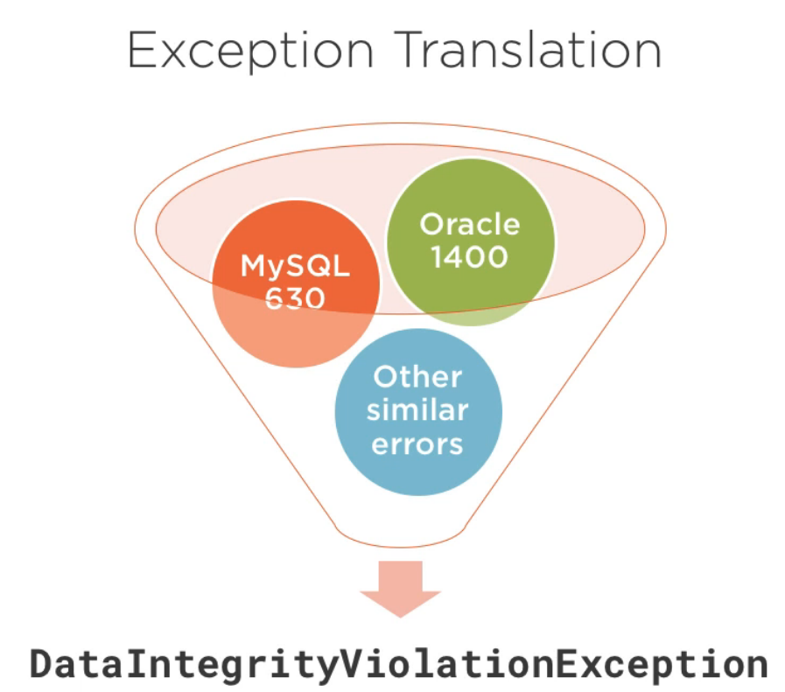
Spring Framework : Data Access

Slide 14
Spring Framework : Integration
How to integrate application with each other?
Remote Method Invocation (RMI)
Messaging Systems
Web Services
Spring Integration helps with…
Expose web services;
Access web services;
Helps expose web service using annotations like:
@RestController, @GetMapping, @PathVariable;
Helps invoke web service using annotations like:
Uses RestTemplate;
Abstracts away connectivity details, sending a request and handling a response;

Slide 15
Spring Framework : Testing
Unit testing;
Tests smallest testable parts, independently;
Dependency Injection is a great help here;
By the way of mocking.
Has pre-built mocks;
Integration testing;
Individual modules are combined and tested as a group;
Provides support for common testing scenarios:
Test with data;
Web app testing;
Clean up after tests (reverse modifications);

Slide 16
Spring Framework : Projects
Spring Data
Extends the Data Access capabilities;
New ways to interact with relational databases;
Support for many different types of databases;
An umbrella project (JDBC, LDAP, MongoDB, Cassandra…)
Spring Cloud
Used for distributed systems;
Helps with service discovery;
@EnableDiscoveryClient make a service discoverable;
An umbrella project (Cloud Foundry, Cloud Security, Cloud Netflix, etc,);
Spring Security
Secure Spring based applications;
Handles authentication and authorization;
Protects against common attacks;

Slide 17

For practice we’ll use…
Spring 5
Java 8
Maven
IntelliJ
Tomcat (embedded)

